Slide 1
Bayesian Deep Learning Based Semantic Segmentation for Marine Environments
UCL, Faculty of Engineering Sciences,
Department of Mechanical Engineering
Student: Zehao Ye (23119333)
Date: 11/09/2024

Slide 2
Content
Background
Objectives
Design
Methodology
Result and Discussion
Conclusion
References
Q & A

Slide 3
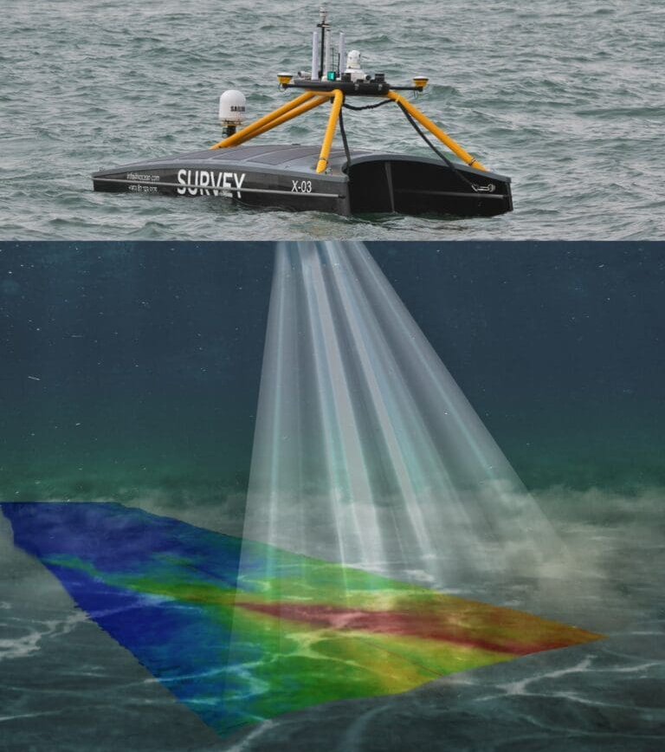
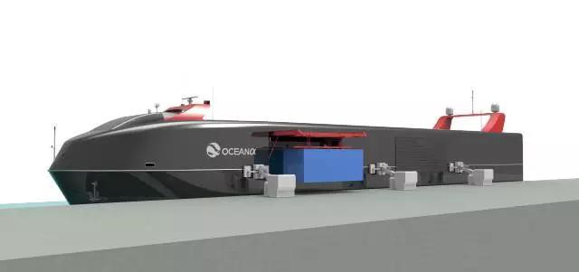
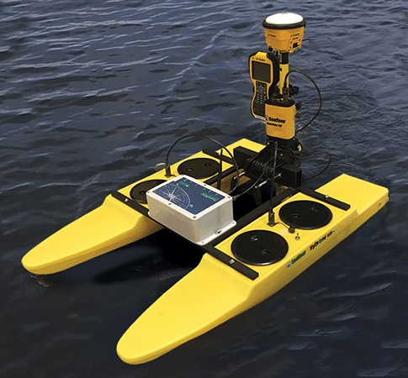
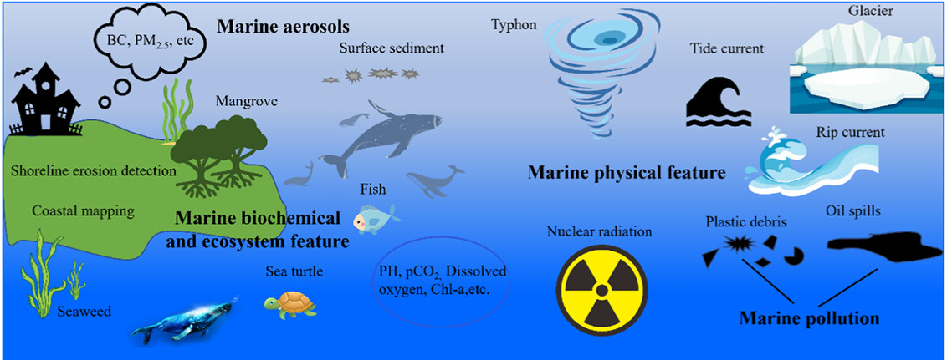
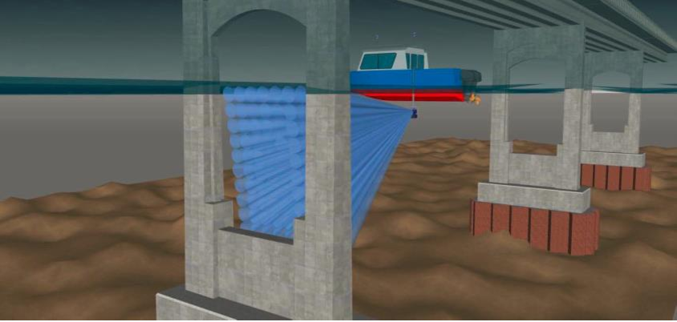
Background
Seabed Mapping [4]
Application of USV (unmanned surface vehicle / vessel)
Commercial Shipping [2]
Environmental Monitoring [3]
Bridge Inspection [5]
[1]
Notes:
Unmanned surface vehicle, known as USV play a crucial role in various fields,
such as commercial shipping, environmental monitoring, seabed mapping and facility inspection.
USVs have significant commercial potential and can replace personnel in hazardous maritime operations.
However, compared to the field of Unmanned Ground Vehicles (UGVs), research in USVs is relatively slower and requires further development.

Slide 4
Objectives
Enhance the visual detection capabilities of USVs
Addresses the challenges posed by dataset scarcity
Improve the performance of USV perception systems in novel scenarios
Use Bayesian deep learning based semantic segmentation to further improve the autonomy of USVs
Notes:
So in this project, the objective

Slide 5
Design
Why use semantic segmentation for improving autonomy ?
Leverage successful experiences from UGV (unmanned ground vehicles) domain
Adapt to the limited payload of USVs
Semantic segmentation for precise obstacle detection
Apply a deep learning approach to perform semantic segmentation
How to implement the deep learning approach?
Architecture selection
Dataset selection
Notes:
Then comes to the design section, I will detail the reason why I chose the algorithm and datasets that I used in my project for marine environment semantic segmentation
Firstly, why use SS for improving the autonomy of USVs

Slide 6
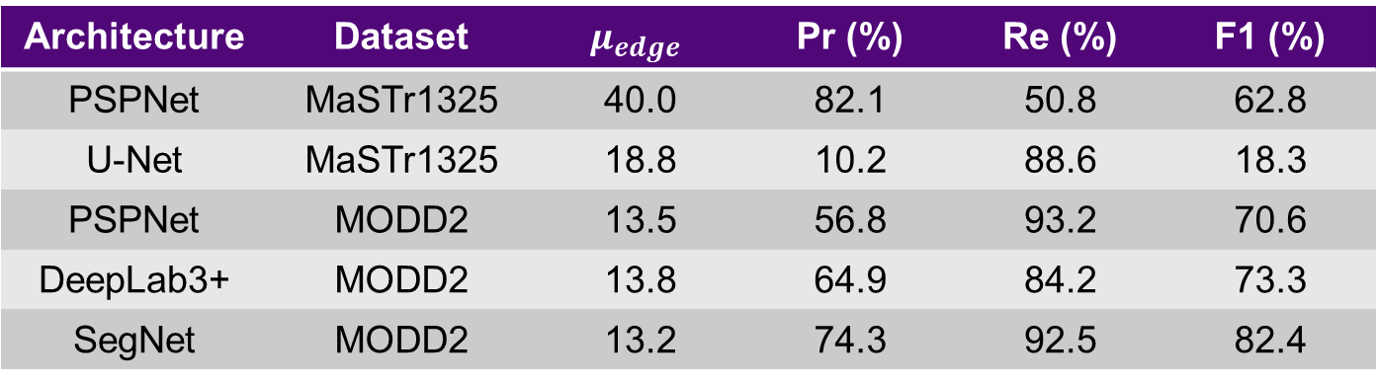
Design
Architecture Selection
Focus on the architectures used for semantic segmentation
PSPNet [6], U-Net [7], the DeepLab family [8], and SegNet [9]
Architectures performances on different maritime dataset [10], [11]
SegNet demonstrates outstanding performance
Architecture | Dataset | $$μ_{edge}$$ | Pr (%) | Re (%) | F1 (%)
PSPNet | MaSTr1325 | 40.0 | 82.1 | 50.8 | 62.8
U-Net | MaSTr1325 | 18.8 | 10.2 | 88.6 | 18.3
PSPNet | MODD2 | 13.5 | 56.8 | 93.2 | 70.6
DeepLab3+ | MODD2 | 13.8 | 64.9 | 84.2 | 73.3
SegNet | MODD2 | 13.2 | 74.3 | 92.5 | 82.4
Notes:
大多数涉及图像处理的深度学习架构都是CNN架构，这是由于

Slide 7
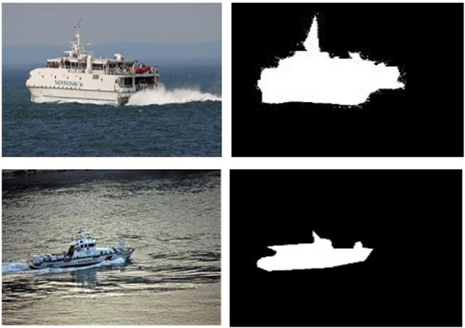
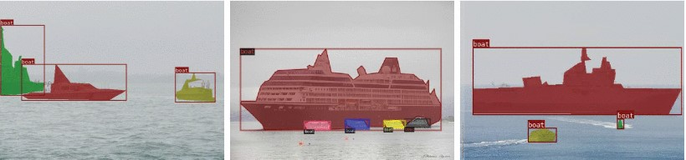
Design
Dataset Selection
Binary annotation datasets: MariShipSeg-HEU and Foggy ShipInsseg
[12]
[13]
Notes:
So what coming next is dataset selection, the number of marine dataset is small than land-scape dataset, and the number of annotation classes is smaller as well.

Slide 8
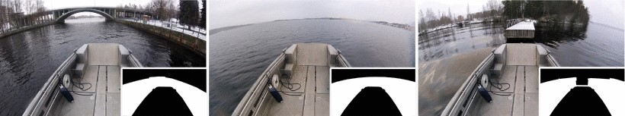
Design
Dataset Selection
Binary annotation dataset: Tampere Waterseg
[14]

Slide 9
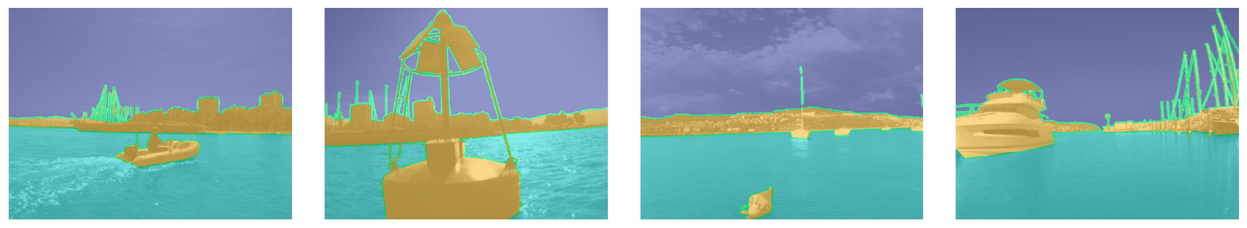
Design
Dataset Selection
Multi-class annotation dataset: MaSTr1325
[15]

Slide 10
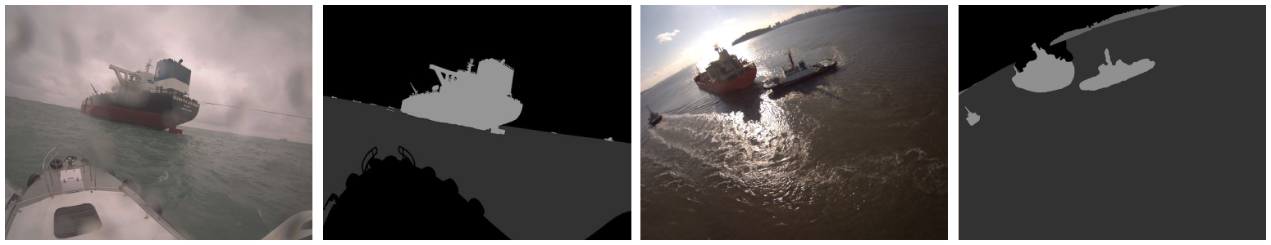
Design
Dataset Selection
Multi-class annotation dataset: OASIs
[16]
Notes:
I use another dataset called OASIs because this dataset make classification about the shooting environments, with a particular emphasis on datasets for night time and harsh conditions.
This dataset can be utilized to evaluate the performance of algorithm under hazard environments.

Slide 11
Design
Why use a Bayesian approach ?
Robust uncertainty estimation for improved reliability
Alex Kendall [17] use Bayesian SegNet to improve accuracy of segmentation by remove inherent noise
Enhanced generalization in complex marine environments
Training models with better generalization on small-scale datasets [18]

Slide 12
Methodology
Dataset Preparation
Bayesian SegNet Algorithm
Evaluation Metrics

Slide 13
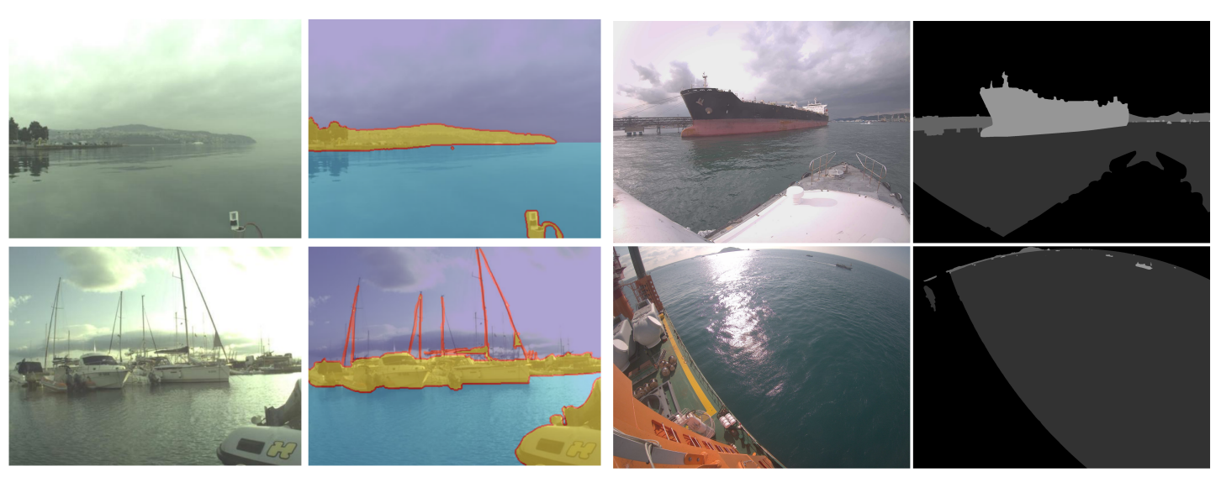
Methodology
Dataset Preparation
Different dataset with different annotation form
Notes:
Mastr1325 use Indexed Image as annotation, but oasis use grayscale image as annotation.

Slide 14
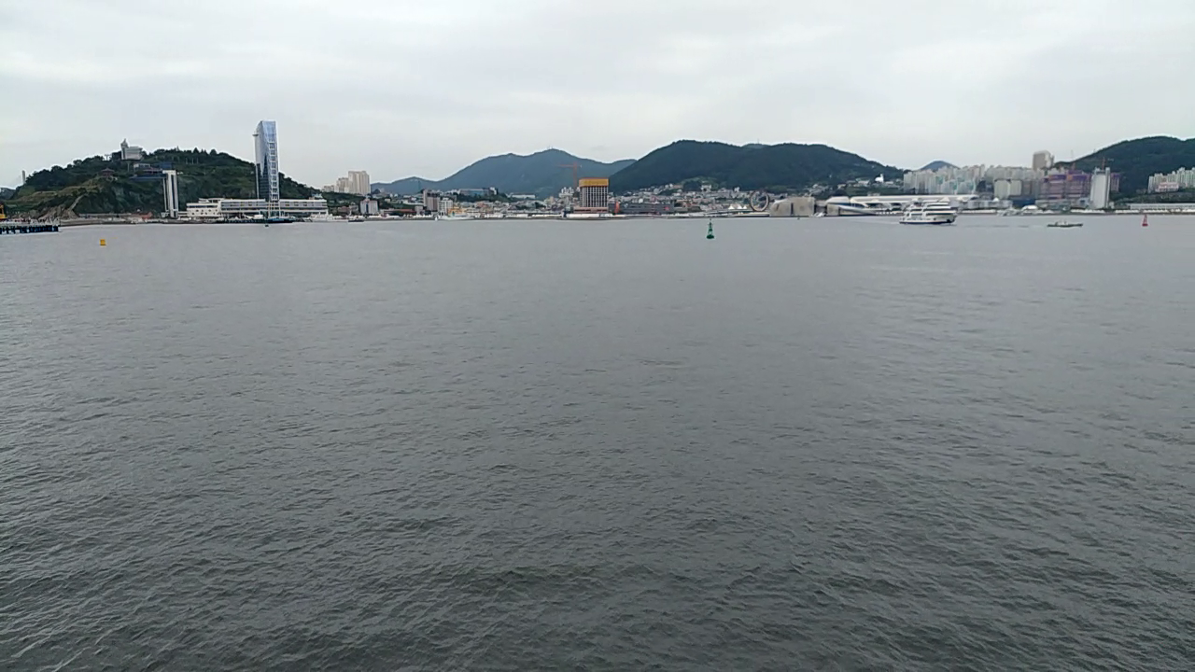

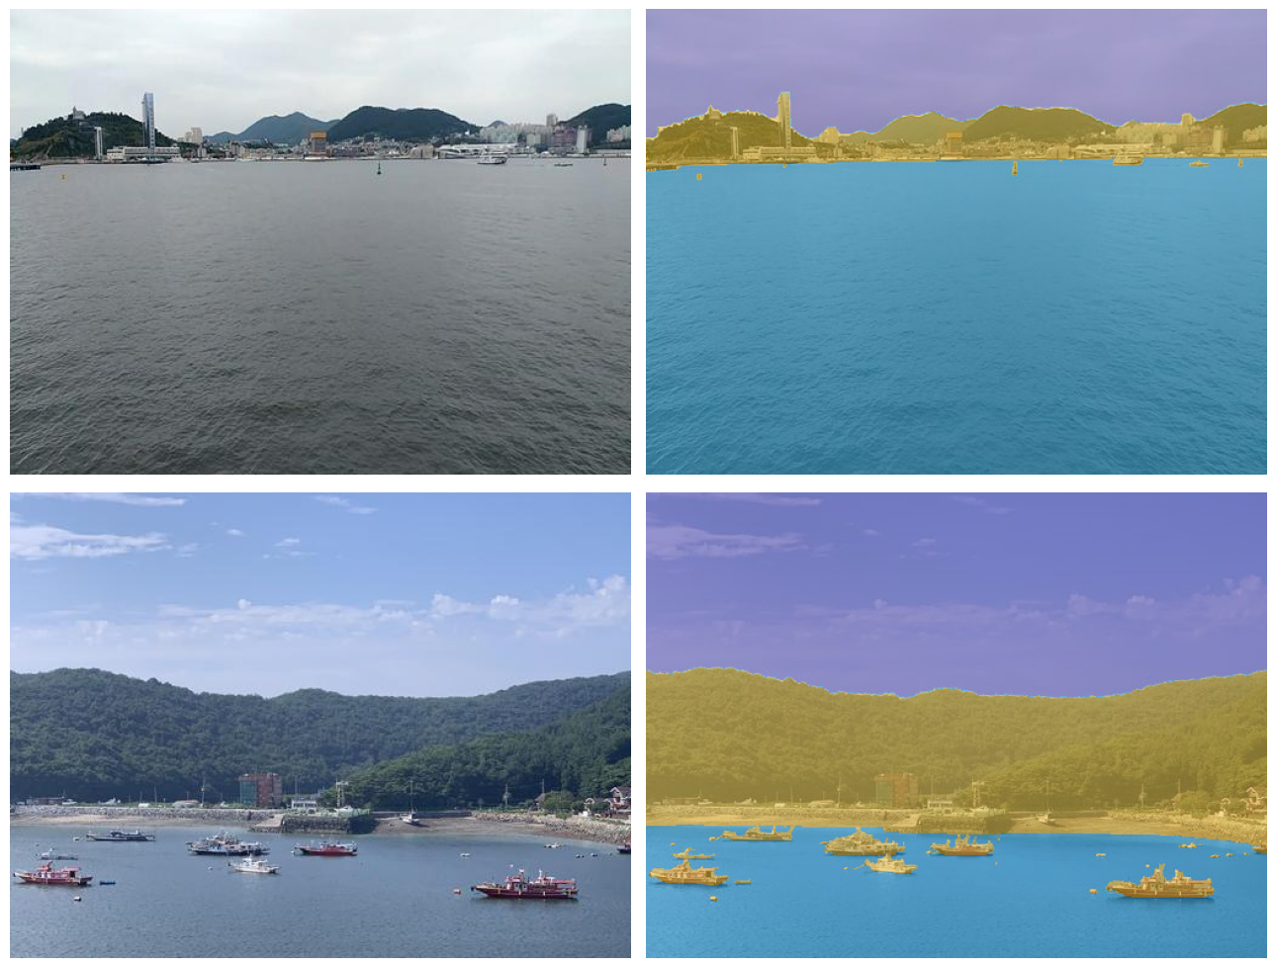
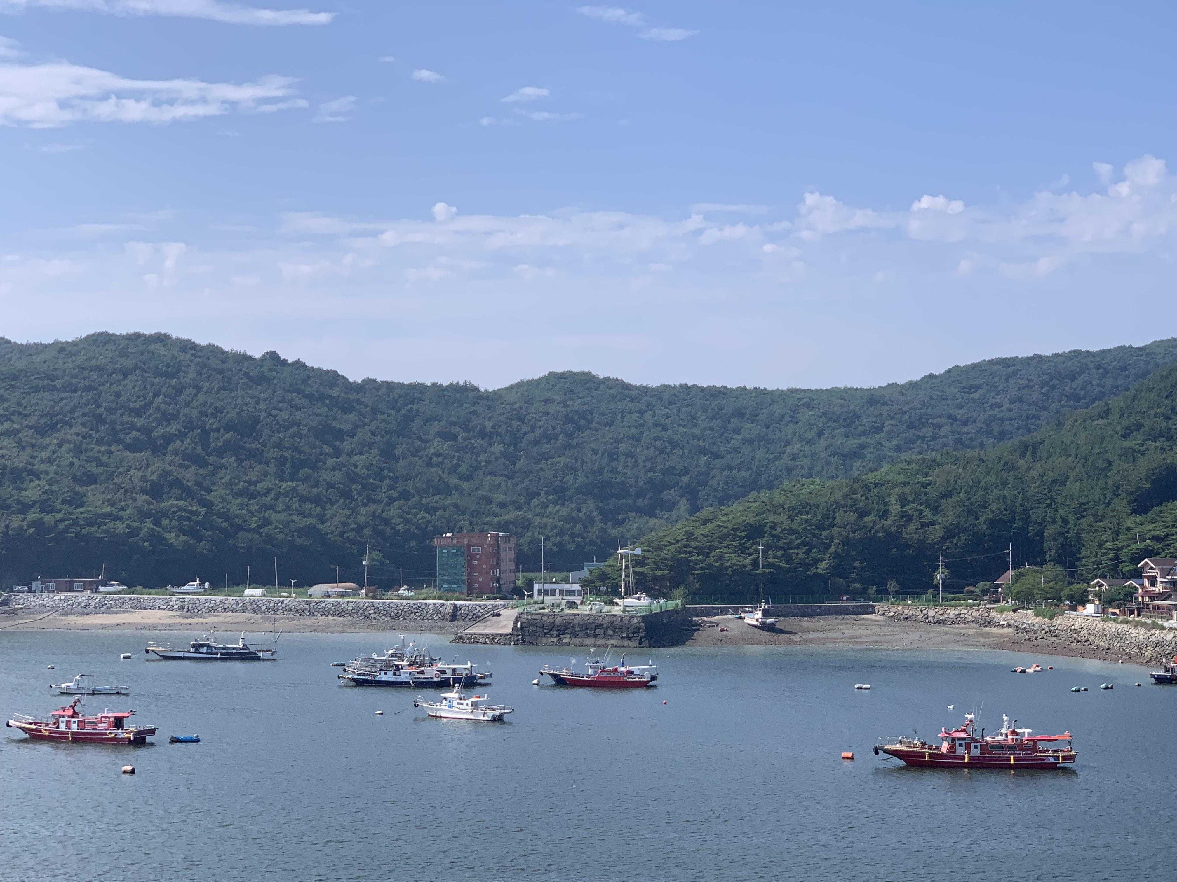

Methodology
Dataset Preparation
re - annotation of OASIs dataset
Notes:
Mastr1325 use Indexed Image as annotation, but oasis use grayscale image as annotation.

Slide 15
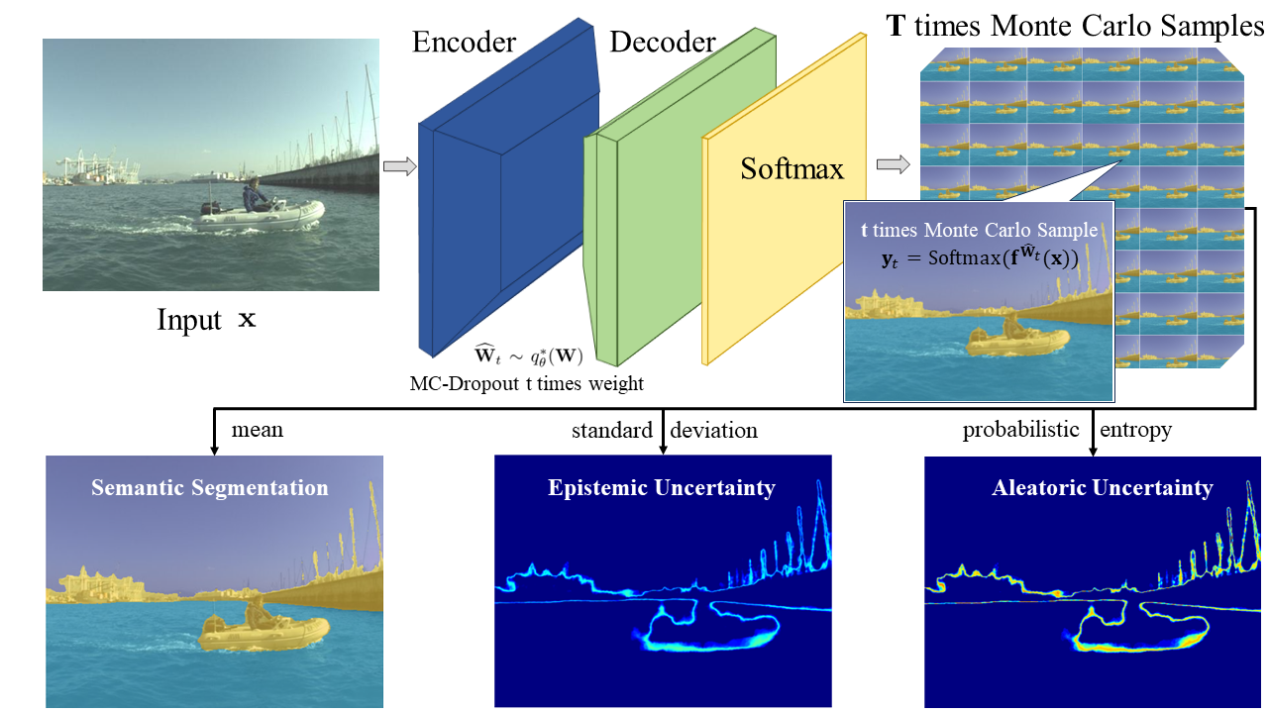
Methodology
Bayesian SegNet Algorithm

Slide 16
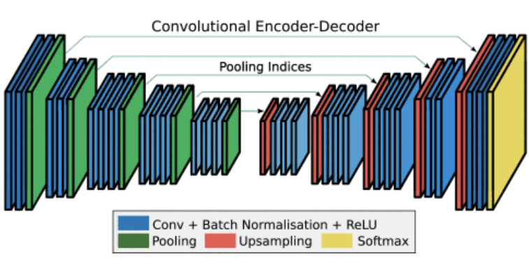
Methodology
Bayesian SegNet Algorithm – SegNet Architecture
[9]

Slide 17
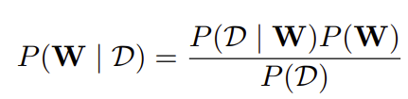
Methodology
Bayesian SegNet Algorithm – MC Dropout
The Bayesian paradigm
: the training dataset, consists of a series of inputs X = {x1, ..., xN } and their
corresponding labels Y = {y1, ..., yN }.
: the weights in the network connection
Notes:
Posterior = prior, likelihood, and evidence

Slide 18
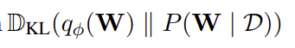
Methodology
Bayesian SegNet Algorithm – MC Dropout
Variational Inference - learn the variational distribution over the network’s weights
Minimise the Kullback-Leibler (KL) divergence between this distribution and posterior distribution
The weight in the variational distribution is achieved through Dropout
Notes:
Define a variational distribution

Slide 19
Methodology
Bayesian SegNet Algorithm – Inference Result
Multiple forward propagations for same input
Semantic segmentation – mean
Epistemic Uncertainty – standard deviation
Aleatoric Uncertainty – distribution entropy
Evaluation Metrics
Typical evaluation metrics for marine semantic segmentation
Precision (Pr), Recall (Re), and the harmonic mean F1 Score

Slide 20
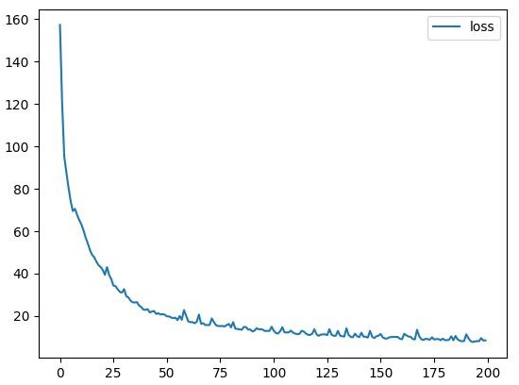
Results and Discussion
Non-Bayesian SegNet on MaSTr1325 dataset
Training loss curve

Slide 21
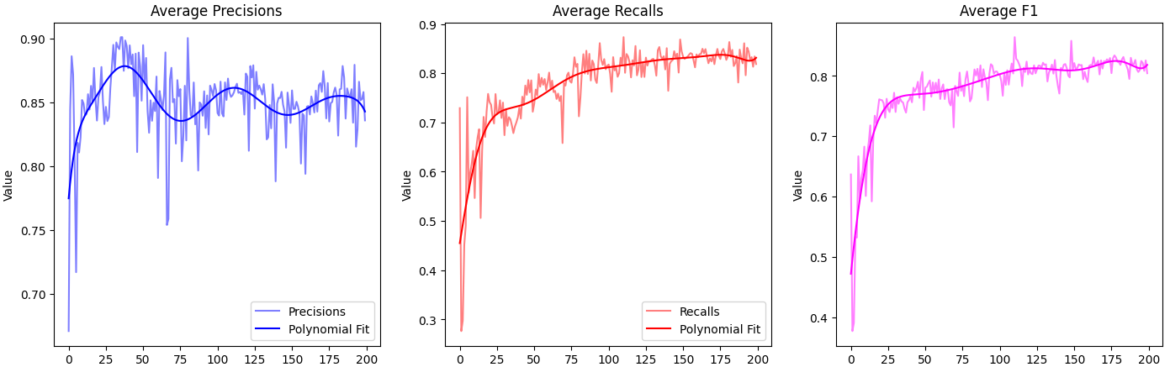
Results and Discussion
Non-Bayesian SegNet on MaSTr1325 dataset
Evaluation curves
Notes:
The evaluation curve fluctuates with epochs
The false positive change severely and cause this situation

Slide 22
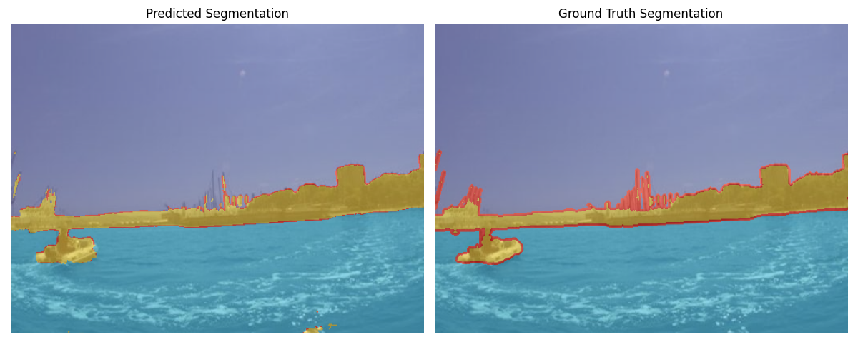
Results and Discussion
Non-Bayesian SegNet on MaSTr1325 dataset
Semantic segmentation result

Slide 23
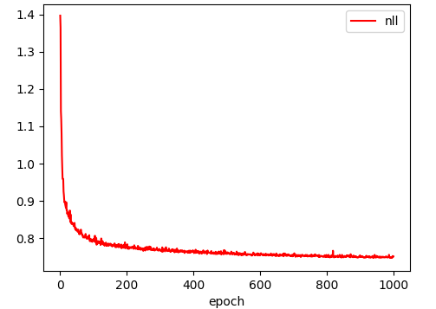
Results and Discussion
Bayesian SegNet on MaSTr1325 dataset
Training loss curve

Slide 24
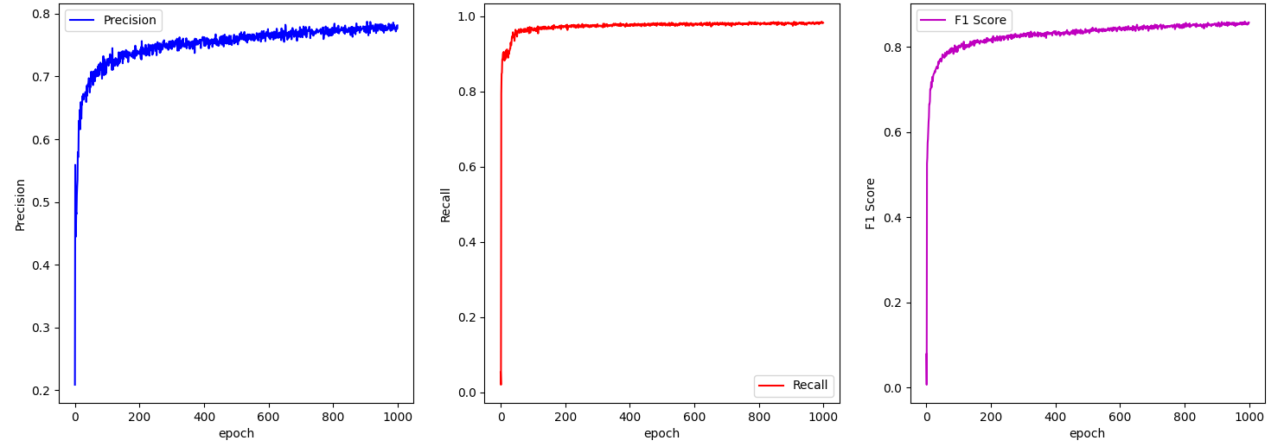
Results and Discussion
Bayesian SegNet on MaSTr1325 dataset
Evaluation curves

Slide 25
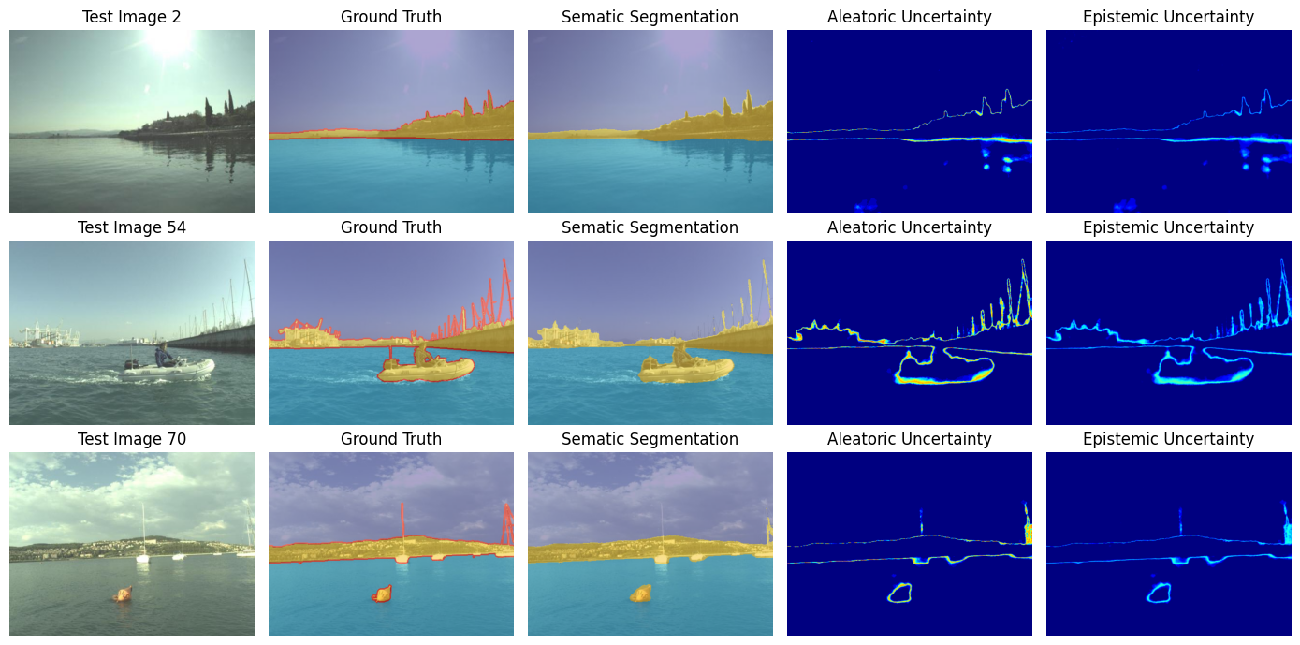
Results and Discussion
Bayesian SegNet on MaSTr1325 dataset
Semantic segmentation and uncertainty estimation

Slide 26
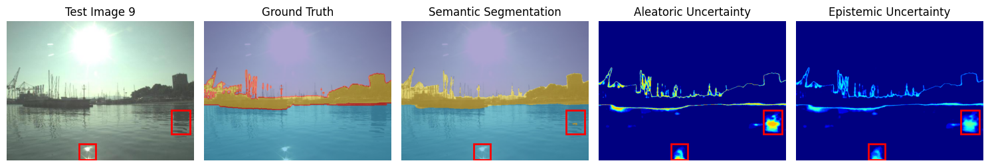
Results and Discussion
Bayesian SegNet on MaSTr1325 dataset
Error annotation with high uncertainty

Slide 27
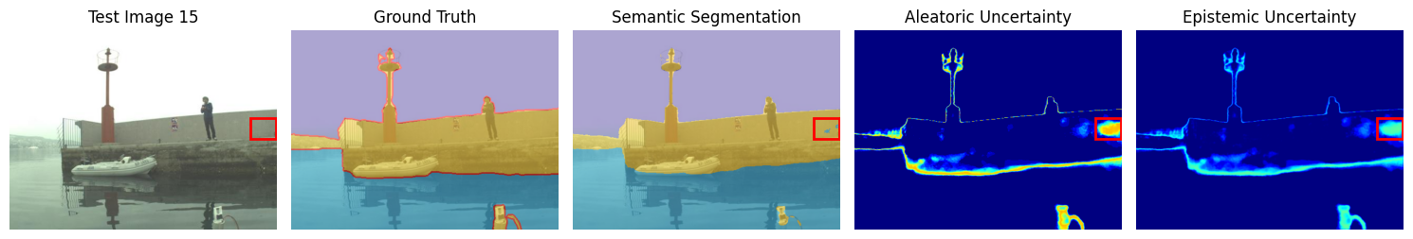
Results and Discussion
Bayesian SegNet on MaSTr1325 dataset
Error annotation with high uncertainty

Slide 28
Results and Discussion
Performance evaluations on MaSTr1325 dataset
Architecture | Pr (%) | Re (%) | F1 (%)
Bayesian SegNet | 81.2 | 97.8 | 87.8
Non-Bayesian SegNet | 79.9 | 87.5 | 81.3
PSPNet | 82.1 | 50.8 | 62.8
U-Net | 10.2 | 88.6 | 18.3
The performance evaluations of PSPNet and U-Net on MaSTr1325 dataset was done by B. Bovcon [11] .

Slide 29
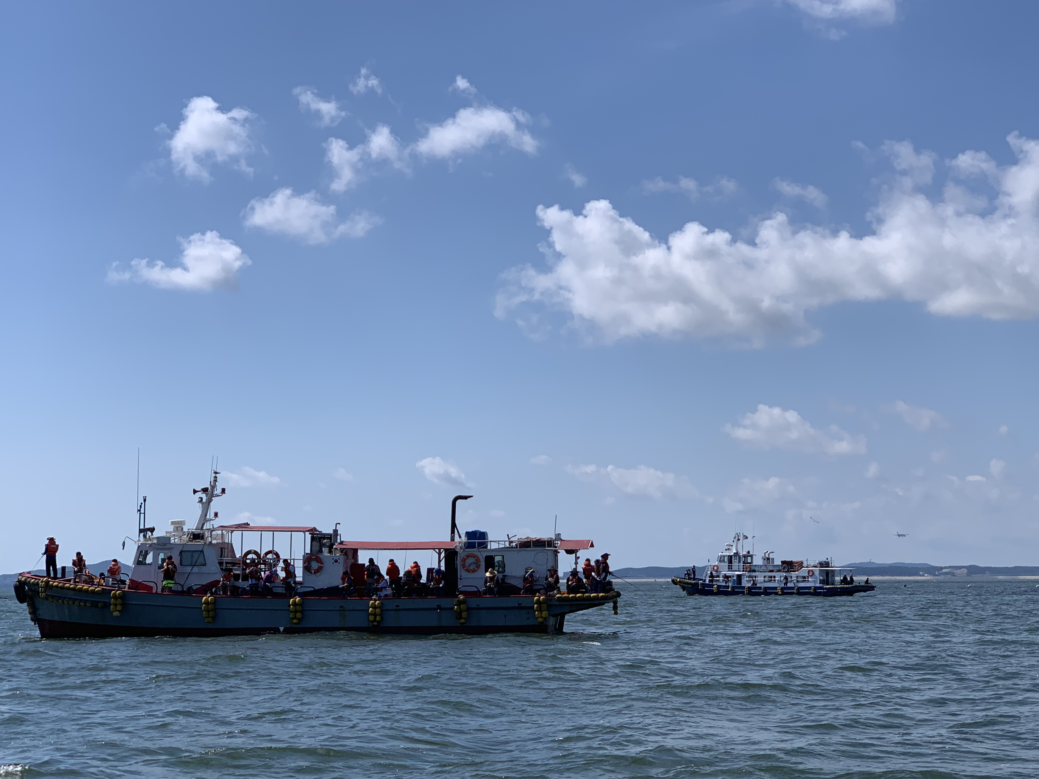
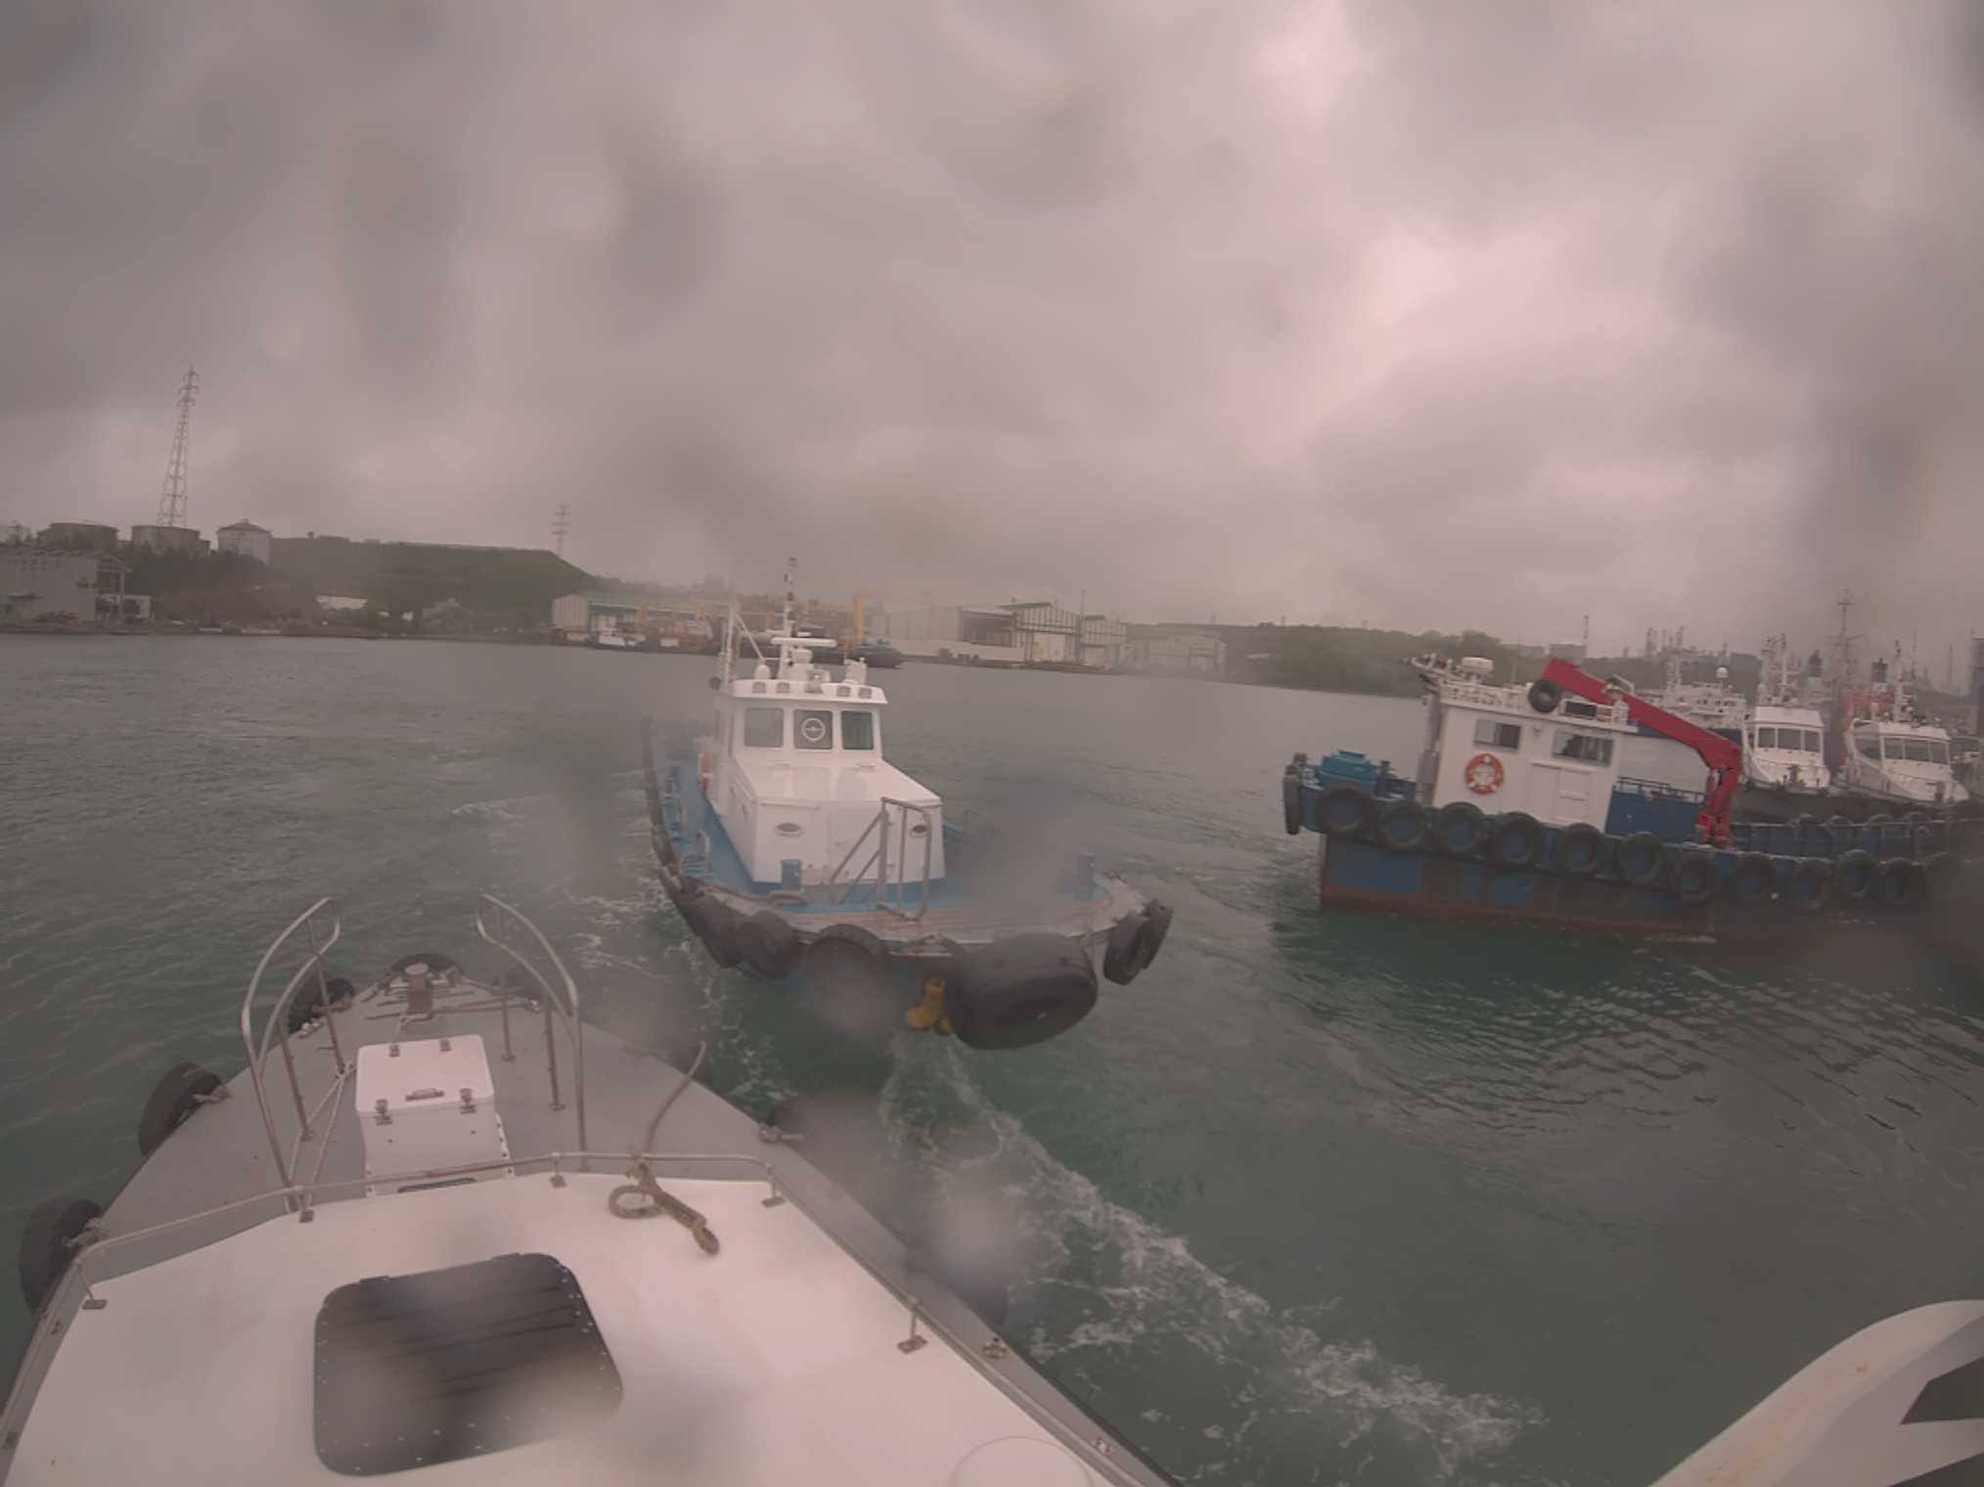
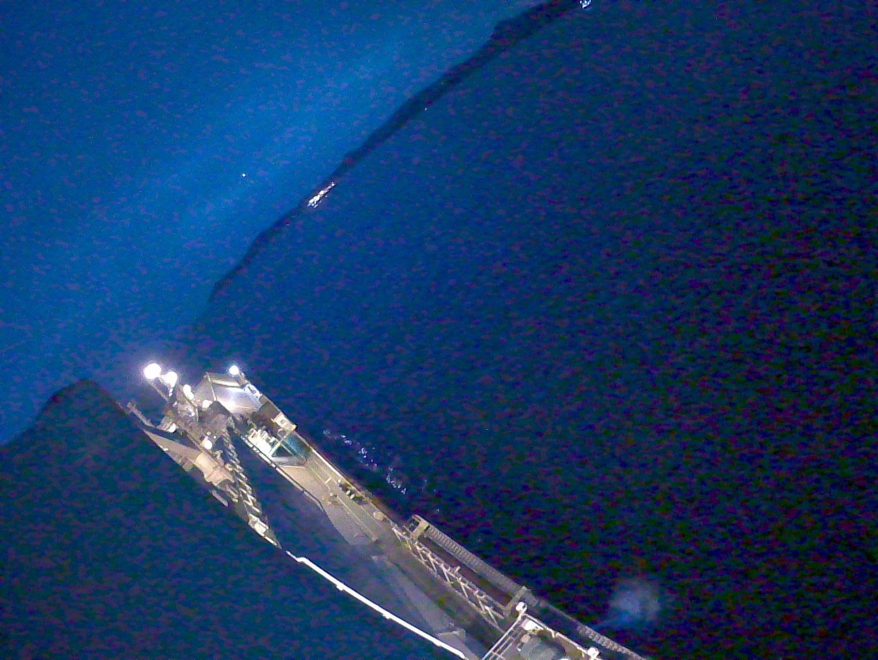
Results and Discussion
Generalization capability evaluation on OASIs dataset
Different types of OASIs dataset
day-time environment
adverse weather environment
night time environment

Slide 30
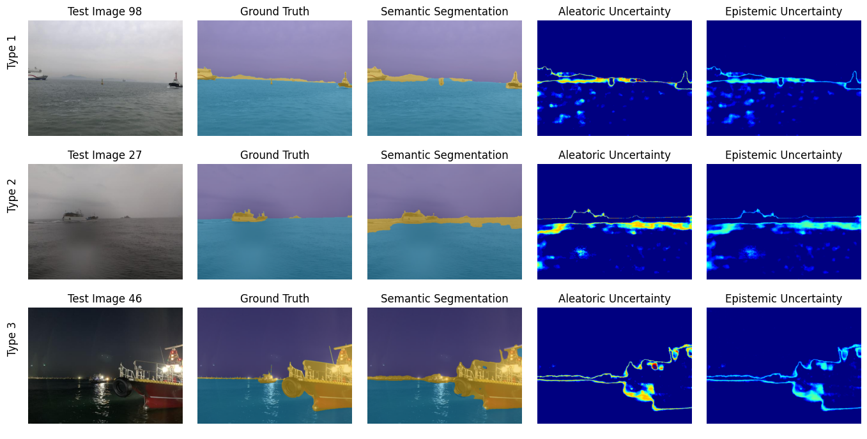
Results and Discussion
Generalization capability evaluation on OASIs dataset
Semantic segmentation and uncertainty estimation

Slide 31
Results and Discussion
Generalization capability evaluation on OASIs dataset
Performance evaluations on OASIs dataset
Architecture | Dataset | Pr (%) | Re (%) | F1 (%)
Bayesian SegNet | OASIs - type1 | 68.73 | 84.31 | 72.67
 | OASIs – type2 | 47.27 | 95.74 | 64.36
 | OASIs – type3 | 65.20 | 88.89 | 73.52
Non-Bayesian SegNet | OASIs - type1 | 28.27 | 65.89 | 33.93
 | OASIs – type2 | 1.69 | 97.17 | 3.32
 | OASIs – type3 | 10.09 | 98.97 | 17.82
SegNet | SMD [19] | 31.2 | 76.3 | 44.3
The performance evaluations of SegNet on OASIs dataset was done by B. Bovcon [20]

Slide 32
Conclusion
The model performance is improved over non-Bayesian baselines :
Pr - 1.3%, F1 Score - 6.5%
Greater generalization capability while testing on the OASIs dataset:
F1 score - 39.77% higher than non-Bayesian baselines
Notes:
by reducing the effect of noisy data through the elimination of aleatoric uncertainty.
which is attributed to the inference ability of the Bayesian approach.

Slide 33
References
[1] iltech.com.vn, “Unmanned surface vessels (USV),” iltech.com.vn. https://iltech.com.vn/en/unmanned-surface-vessels-usv.html
[2] “Oceanalpha Develops Commercial Shipping USV | OceanAlpha,” OceanAlpha, Jul. 05, 2019. https://www.oceanalpha.com/application_cases/oceanalpha-develops-commercial-shipping-usv/ (accessed Sep. 08, 2024).
[3] S. Yuan et al., “Marine environmental monitoring with unmanned vehicle platforms: Present applications and future prospects,” Science of The Total Environment, vol. 858, p. 159741, Feb. 2023, doi: https://doi.org/10.1016/j.scitotenv.2022.159741.
[4] admin, “Technology | XOCEAN,” Xocean.com, Apr. 27, 2023. https://xocean.com/technology/ (accessed Sep. 08, 2024).
[5] Karl von Ellenrieder and J. Wampler, “Unmanned Surface Vessel (USV) Systems for Bridge Inspection.,” Aug. 2016.
[6] H. Zhao et al., “Pyramid scene parsing network,” in Proceedings of the IEEE conference on computer vision and pattern recognition, pp. 2881–2890, 2017.
[7] O. Ronneberger, P. Fischer, and T. Brox, “U-net: Convolutional networks for biomedical image segmentation,” in Medical image computing and computer-assisted intervention–MICCAI 2015: 18th international conference, Munich, Germany, October 5-9, 2015, proceedings, part III 18, pp. 234–241, Springer, 2015.
[8] L.-C. Chen, Y. Zhu, G. Papandreou, F. Schroff, and H. Adam, “Encoder-decoder with atrous separable convolution for semantic image segmentation,” in Proceedings of the European conference on computer vision (ECCV), pp. 801–818, 2018.
[9] V. Badrinarayanan, A. Kendall, and R. Cipolla, “Segnet: A deep convolutional encoder-decoder architecture for image segmentation,” IEEE transactions on pattern analysis and machine intelligence, vol. 39, no. 12, pp. 2481–2495, 2017.
[10] B. Bovcon and M. Kristan, “Wasr—a water segmentation and refinement maritime obstacle detection network,” IEEE Transactions on Cybernetics, vol. 52, no. 12, pp. 12661–12674, 2022.
[11] B. Bovcon, J. Muhovic, J. Per ˇ s, and M. Kristan, “The mastr1325 dataset for training deep usv obstacle ˇ detection models,” in 2019 IEEE/RSJ International Conference on Intelligent Robots and Systems (IROS), IEEE, 2019
[12] W. Zhang, X. He, W. Li, Z. Zhang, Y. Luo, L. Su, and P. Wang, “An integrated ship segmentation method based on discriminator and extractor,” Image and Vision Computing, vol. 93, p. 103824, 2020.

Slide 34
References
[13] Y. Sun, L. Su, Y. Luo, H. Meng, Z. Zhang, W. Zhang, and S. Yuan, “Irdclnet: Instance segmentation of ship images based on interference reduction and dynamic contour learning in foggy scenes,” IEEE Transactions on Circuits and Systems for Video Technology, vol. 32, no. 9, pp. 6029–6043, 2022.
[14] J. Taipalmaa, N. Passalis, H. Zhang, M. Gabbouj, and J. Raitoharju, “High-resolution water segmentation for autonomous unmanned surface vehicles: a novel dataset and evaluation,” in 2019 IEEE 29th International Workshop on Machine Learning for Signal Processing (MLSP), pp. 1–6, 2019.
[15] B. Bovcon, J. Muhovic, J. Per ˇ s, and M. Kristan, “The mastr1325 dataset for training deep usv obstacle ˇ detection models,” in 2019 IEEE/RSJ International Conference on Intelligent Robots and Systems (IROS), IEEE, 2019
[16] Y. Kim, J. Park, S. Kang, and H. Kim, “Introducing vada: Novel image segmentation model for maritime object segmentation using new dataset,” arXiv preprint arXiv:2407.09005, 2024.
[17] A. Kendall and Y. Gal, “What uncertainties do we need in bayesian deep learning for computer vision?,” Advances in neural information processing systems, vol. 30, 2017.
[18] Y. Hou, E. Zheng, W. Guo, Q. Xiao and Z. Xu, "Learning Bayesian Network Parameters With Small Data Set: A Parameter Extension under Constraints Method," in IEEE Access, vol. 8, pp. 24979-24989, 2020, doi: 10.1109/ACCESS.2020.2971099.
[19] D. K. Prasad, D. Rajan, L. Rachmawati, E. Rajabally and C. Quek, "Video Processing From Electro-Optical Sensors for Object Detection and Tracking in a Maritime Environment: A Survey," in IEEE Transactions on Intelligent Transportation Systems, vol. 18, no. 8, pp. 1993-2016, Aug. 2017, doi: 10.1109/TITS.2016.2634580.
[20] B. Bovcon and M. Kristan, "WaSR—A Water Segmentation and Refinement Maritime Obstacle Detection Network," in IEEE Transactions on Cybernetics, vol. 52, no. 12, pp. 12661-12674, Dec. 2022, doi: 10.1109/TCYB.2021.3085856.

Slide 35
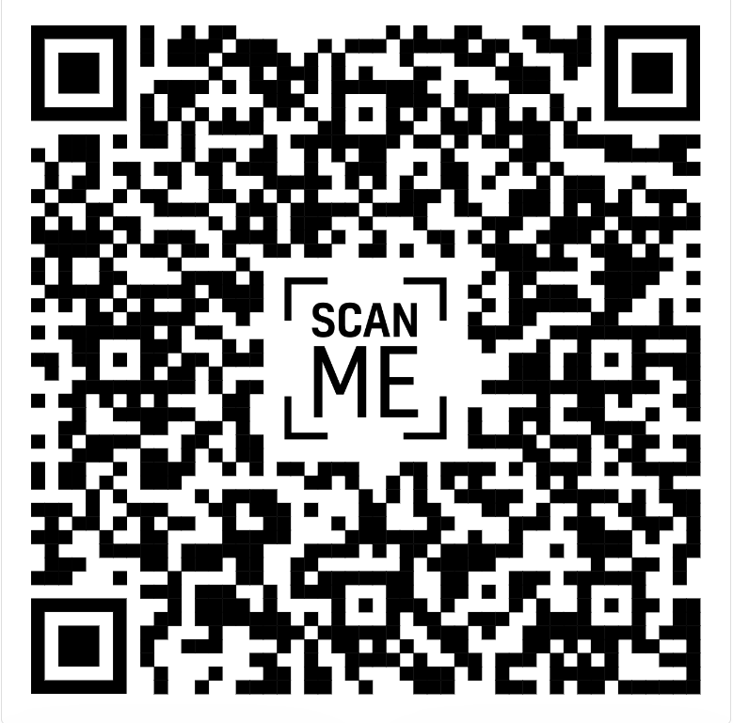
Q & A GitHub repository

